Slide 1
“10% of the time, it works every time” Recognizing sloppy science
Jim Broach
Penn State College of Medicine
Reprise of talk given by C. Glenn Begley,
former Director of Oncology, Amgen

Slide 2
Between 2002-2012, Amgen was not able to reproduce 47of 53 seminal publications. These were publications that reported something completely “new” In the majority, data was not reproduced by the original investigators with their reagents in their lab Amgen’s experience is not unique….
Begley and Ellis. Nature (2012) 483: 531

Slide 3
Begley’s position statement
These results do not challenge the validity or legitimacy of the scientific method
Not talking about fraud: the subject is scientific-laziness, sloppiness, ignorance, exaggeration, desperation
The vast majority of investigators want to do the right thing
That this debate is occurring in public confirms the strength our scientific system

Slide 4
BE SKEPTICAL

Slide 5
High-profile studies typically fail at multiple levels:
Begley’s six criteria for judging scientific reports:
Were studies blinded?
Almost never
2) Were all results shown?
Typically not “representative examples” & data selection bias
western blots that show only a slice; no size markers
3) Were experiments repeated?
Often not westerns/immuno-precipitation usually only performed once
typically only use 1/2 siRNAs and in 1/2 cell lines
confusion between replicates and independent experiments
4) Were positive and negative controls shown?
Typically not
5) Were reagents validated?
Frequently not IHC with a polyclonal anti-peptide Ab
small molecule inhibitors
6) Was the analysis appropriate (e.g. cell growth/statistical tests)?
Typically not
Begley. Nature (2013) 497; 433

Slide 6
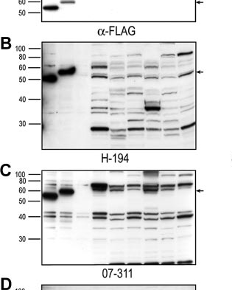
Were all the results shown?
Versus
Investigators hide
poor experiments
by failing to show all
the data
“Anti-EPOR” antibodies
Elliott et al. Blood (2006) 107: 1892

Slide 7
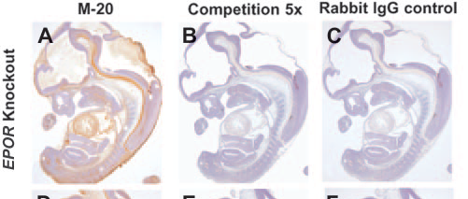
Were positive and negative controls shown?
Beware using polyclonal anti-peptide antibodies
Beware “illegitimate” controls
Here competition experiments are not the appropriate control
- an apparent control may not be a control
Elliott et al. Blood (2006) 107: 1892

Slide 8
Reviewers, Editors of “top-tier” journals, Grant Review Committees, Promotion Committees, and the scientific community repeatedly tolerate poor quality science These studies typically fail at multiple levels. “Famous scientists” and “Top institutions” are repeatedly given a free-pass Some examples but you can find more every time you open a ‘top-tier’ journal

Slide 9
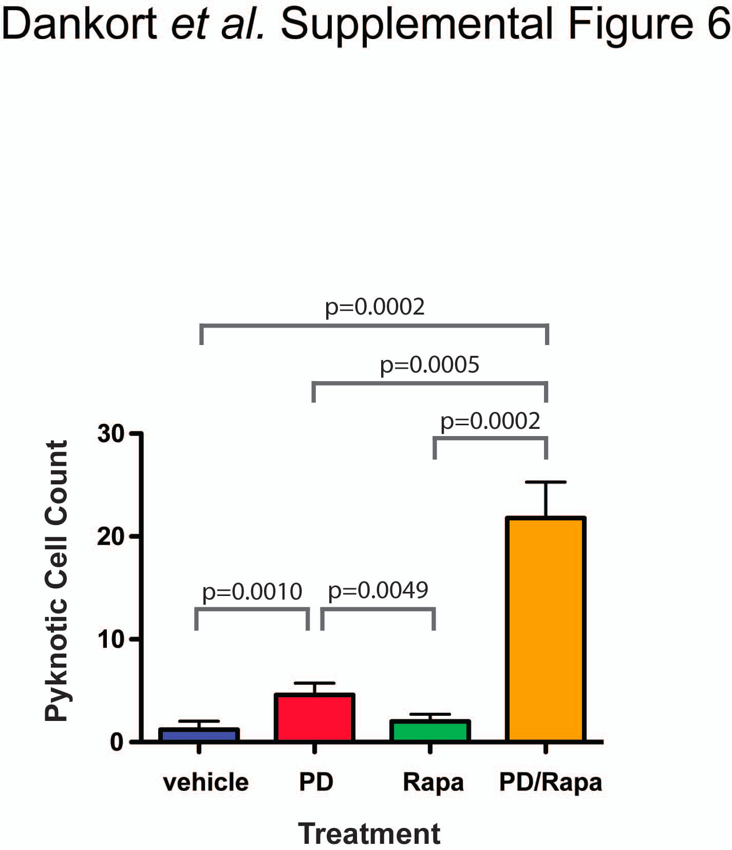
Authors’ Interpretation: Difference in number of dead cells five separate fields of H&E stained paraffin tumor sections were quantified for the presence of pyknotic nuclei per square millimeter by visual inspection.
Example #1.
Approx 450 citations

Slide 10
Authors’ Interpretation: Difference in number of dead cells Five separate fields of H&E stained paraffin tumor sections were quantified for the presence of pyknotic nuclei per square millimeter by visual inspection.
Highly subjective assay not performed blinded
Errors very tight: confusion between replicates vs repeats?
p values unbelievable
Approx 450 citations

Slide 11
Authors’ Interpretation: Difference in cell number between 3 cell populations
Crystal Violet assay
6
Vehicle
PD325809
4
Rapamycin
Relative cell number
2
1 2 3 4
Time (d)
Example #1.
Approx 450 citations

Slide 12
Authors’ Interpretation: Difference in cell number between 3 cell populations
Crystal Violet assay
6
Vehicle
PD325809
4
Rapamycin
Relative cell number
2
1 2 3 4
Time (d)
n and errors not stated
Replicates? Repeats? Not stated
Cell proliferation is an exponential, not a linear function
Beware results presented as “relative cell number” (what does it even mean?)
Approx 450 citations

Slide 13
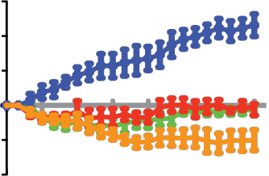
Authors’ Interpretation: Difference in tumor growth between different cohorts
60
40
20
Tumor size change %
0
-20
-40
3 6 9 12 15 18 21
Time (d)
Approx 450 citations

Slide 14
Authors’ Interpretation: Difference in tumor growth between different cohorts
n = ? Errors? not stated
60
40
20
Tumor size change %
0
-20
-40
3 6 9 12 15 18 21
Time (d)
Approx 450 citations

Slide 15
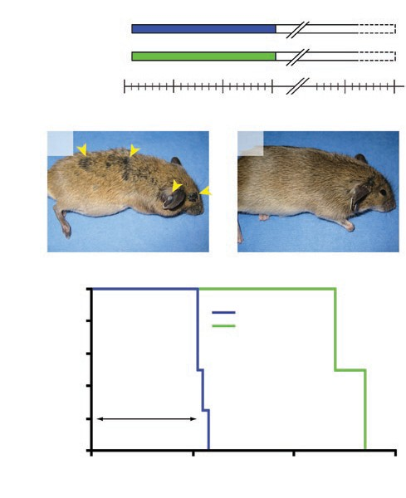
Authors’ Interpretation: Improved mouse survival
100
n=4
80
n=5
60
Survival %
40
20
20
40
60
Days
Approx 450 citations

Slide 16
Authors’ Interpretation: Improved mouse survival
Death of 2.5 mice!
100
n=4
Death of 2.5 mice!
80
n=5
60
Survival %
40
20
20
40
60
Days
Was the paper actually read by the co-authors (n=10)? Reviewers? Editors? Scientific community?
Approx 450 citations

Slide 17
BE SKEPTICAL

Slide 18
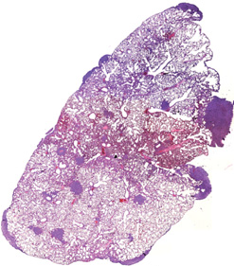

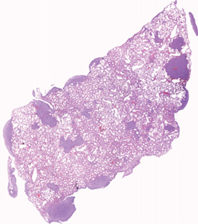
Authors’ Interpretation: “However, metastasis was greatly enhanced…”
8
4
Example #2.
Citations >130

Slide 19
Authors’ Interpretation: “However, metastasis was greatly enhanced…”
8
4
Highly subjective analysis not performed blinded
n and errors not stated
Errors are unbelievable
Beware results presented as percentage
Citations >130

Slide 20
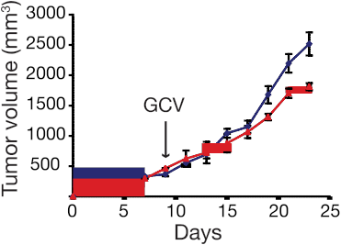

Authors’ Interpretation: Difference in tumor growth
Citations >130

Slide 21
Authors’ Interpretation: Difference in tumor growth
n and errors not stated.
Errors unbelievable
Beware “statistical significance” that is of no biological significance
Citations >130

Slide 22
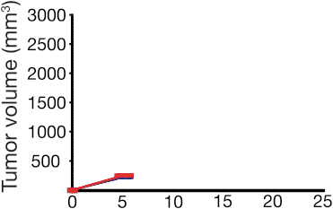
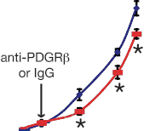
Authors’ Interpretation: Decreased tumor growth
Error bars display SEM; *p < 0.05;
Example #2.
Citations >130

Slide 23
Authors’ Interpretation: Decreased tumor growth
Error bars display SEM; *p < 0.05
n= not stated. Errors unbelievable.
Beware “statistical significance” that is of no biological significance
Beware * against only selected points
Citations >130

Slide 24
“…targeting of Met using PF2341066 inhibited the EMT program shift
and suppressed metastasis…Although PF2341066 is also an inhibitor
of ALK, quantitative RT-PCR (data not shown) and immunostaining
revealed that ALK was not expressed in 4T1 tumors with or
without PF2341066 treatment..”
Example #2.
Citations >130

Slide 25
Were positive and negative controls included/shown?
“…targeting of Met using PF2341066 inhibited the EMT program shift
and suppressed metastasis…Although PF2341066 is also an inhibitor
of ALK, quantitative RT-PCR (data not shown) and immunostaining
revealed that ALK was not expressed in 4T1 tumors with or
without PF2341066 treatment..”
AND
Ignoring the fact that PF2341066 targets 16 kinases
Example #2.
Citations >130

Slide 26
BE SKEPTICAL

Slide 27
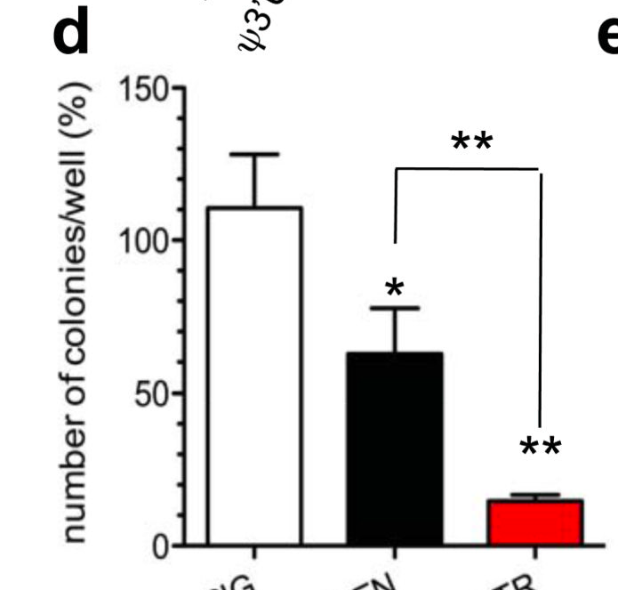
Authors’ Interpretation: Decreased colony formation
Cell Line
Method: 5x10⁴ cells in each well of a 6-well dish,
colony growth scored at 3-4 weeks @ 40x magnification
Example #3.
Approx 800 citations

Slide 28
Authors’ Interpretation: Decreased colony formation
Cell Line
Method: 5x10⁴ cells in each well of a 6-well dish,
colony growth scored at 3-4 weeks @ 40x magnification
Cloning efficiency ~50% implies 25,000 colonies per well (35mm diam x 18mm deep)
A reasonable number of 100 colonies, would require cloning efficiency of ~0.2%
Beware results expressed as percentage
Approx 800 citations

Slide 29
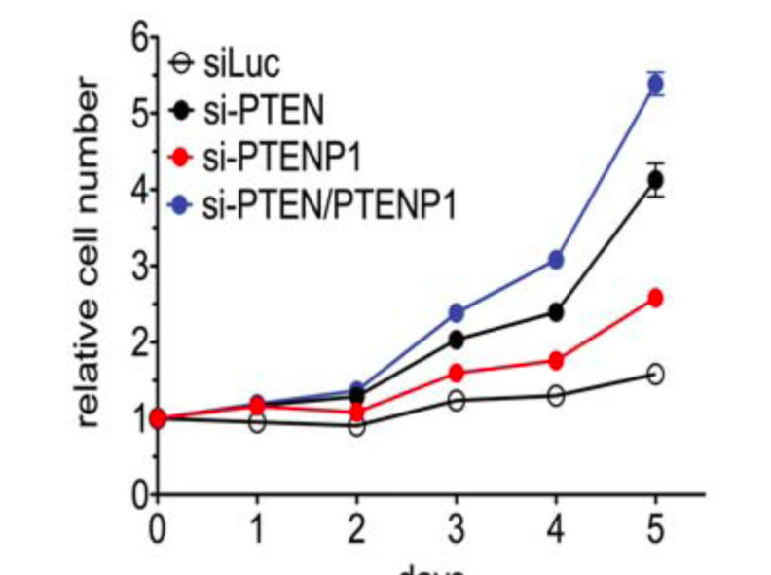
Authors’ Interpretation: “Transfection accelerated cell proliferation,
suggesting that X can exert a biological activity”
Red vs control
Blue vs Black
Cell Line
n > 3
Assay: Crystal violet
Control cells
days
Approx 800 citations

Slide 30
Authors’ Interpretation: “Transfection accelerated cell proliferation,
suggesting that X can exert a biological activity”
Red vs control
Blue vs Black
Cell Line
n > 3
Assay: Crystal violet
Control cells
days
Control cells “stationary”: why is this cell line not proliferating over 5 days?
Tiny errors suggest replicate, not n>3 experiments
Linear not logarithmic Scale
Subjective assay not blinded
Relative, not absolute cell number
Approx 800 citations

Slide 31
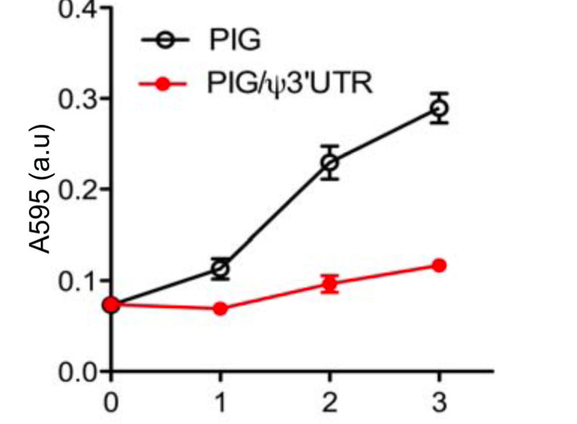
In one Figure an increase is attributed to
experimental manipulation, in another it is the converse
Control
Control
days
days
The same, control cells “stationary” for 5 days in one experiment,
but proliferating over 3 days in the next
….multiple examples in this paper
Approx 800 citations

Slide 32
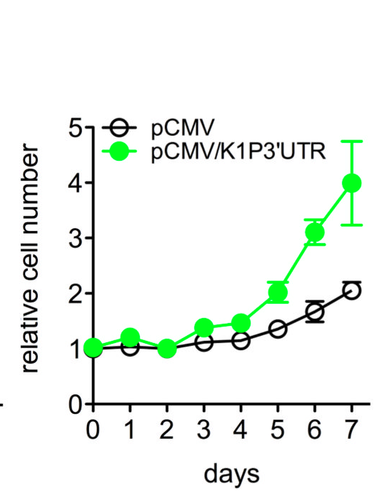
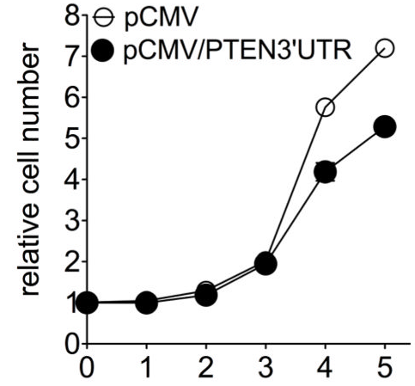
Authors’ Interpretation: “Importantly, X overexpression was accompanied by growth inhibition…Y overexpression accelerated growth”
Gene X
Gene Y
relative cell number
days
Control
days
Approx 800 citations

Slide 33
Authors’ Interpretation: “Importantly, X overexpression was accompanied by growth inhibition…Y overexpression accelerated growth”
Gene X
Gene Y
relative cell number
Single experiments
Linear Scale
No transfection controls
Control cells growing in left panel, but not on right Relative not absolute cell number
days
Control
days
Approx 800 citations

Slide 34
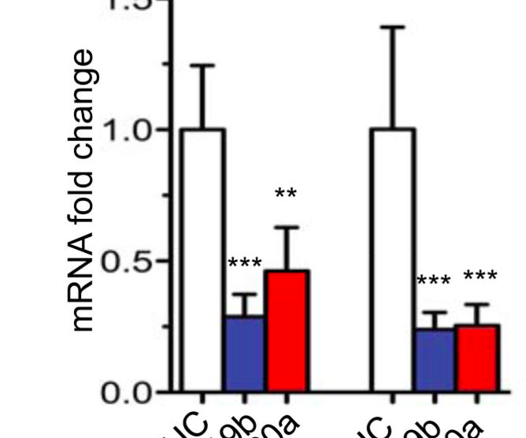
Authors’ Interpretation: “Targeting with siRNA #1 and siRNA #2 decreased Gene X and Gene Y mRNA abundance”.
Gene X
Gene Y
Non-
Targeting
siRNA
#1 #2 #1 #2
Non-
Targeting
siRNA
Targeting
siRNA
Targeting
siRNA
Approx 800 citations

Slide 35
Authors’ Interpretation: “Targeting with siRNA #1 and siRNA #2 decreased Gene X and Gene Y mRNA abundance”.
Gene X
Gene Y
Non-
Targeting
siRNA
#1 #2 #1 #2
Non-
Targeting
siRNA
Targeting
siRNA
Targeting
siRNA
Lacks key negative control: specificity of siRNA #1 and siRNA#2
Biological versus statistical significance of 50% decrease in mRNA
No raw data shown
Approx 800 citations

Slide 36
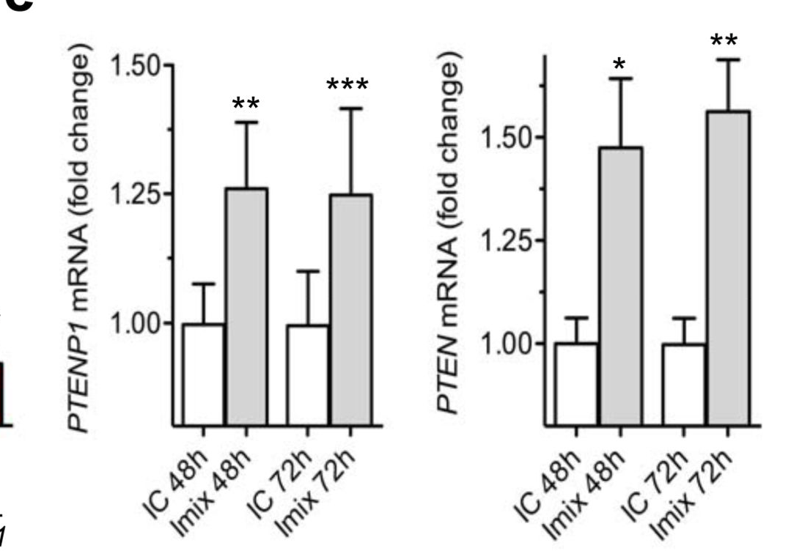
Authors’ Interpretation: A pool of micro-RNA inhibitors targeting Gene X de-repressed both Gene X and Gene Y
Gene X
Gene Y
IC = microRNA inhibitor
negative control
lmix = a pool of inhibitors
of Gene X
Approx 800 citations

Slide 37
Authors’ Interpretation: A pool of micro-RNA inhibitors targeting Gene X de-repressed both Gene X and Gene Y
Gene X
Gene Y
IC = microRNA inhibitor
negative control
lmix = a pool of inhibitors
of Gene X
Lacks key negative control: specificity of inhibitors
Biological versus statistical significance? is 25% increase in mRNA relevant?
No raw data shown
Approx 800 citations

Slide 38
Additional concerns
A single cell line was studied
The majority of experiments were performed only once
No experiment stated to be performed blinded
In transient-transfection experiments, no data re percent
of cells expressing construct
No evidence that transfected constructs were actually expressed
No evidence that antibodies were specific
Was the paper actually read by the
co-authors (n=6)?
Reviewers?
Editors?
Scientific community?
Approx 800 citations

Slide 39
There is an overwhelming bias towards publishing positive studies
Smaller, underpowered studies are more likely to yield positive results than appropriately powered studies:
Of 525 preclinical stroke studies only 2% reported a lack of effect
Reviewed in Begley & Ioannidis. Circulation Research: 116; 116-126, 2015

Slide 40
BE SKEPTICAL

Slide 41
Investigators and Institutions are primarily responsible for research integrity
Institutions must take greater responsibility for investigators unable to “self-censor”
Institutions:
take substantial overheads
bathe in the reflected glory of their PIs
- trumpet findings to donors and media
- allow un-substantiated claims regarding research implications
take insufficient responsibility for the students, post-docs
take little responsibility for ensuring the standard of PIs
give little recognition to excellent teachers/mentors
do not require compliance with standard research methods
do not monitor compliance with guidelines
do not require/review compliance with data access
do not review lab records
Should demand “Good Institutional Practice”
Begley, Dirnagl, Buchan. Nature (2015) 525: 25-27

Slide 42
Conclusions
We have a systemic problem
Our system tolerates (encourages?) these behaviors
The principal responsibility rests with the Investigator
and their host Institution
This requires a multi-pronged approach:
Institutions, Funders, Journals, Advocates, Press
Patients expect, and certainly deserve, more

Slide 43

Recommendation:
Investigators, Institutions,
Reviewers, Funding Agencies, Consumers, Advocates, Press should demand:
STUDIES ARE BLINDED
2) All results are shown
3) Experiments are repeated
4) Positive and negative controls
are shown
5) Reagents are validated
6) Appropriate tests are applied

